Slide 1
OWASP Software Assurance Maturity Model (SAMM)
OSS19
Bart De Win
Sebastien Deleersnyder

Slide 2



OWASP SAMM
Why OWASP SAMM?
Measurable
Defined maturity levels across business practices
Actionable
Clear pathways for improving maturity levels
Versatile
Technology, process, and organization agnostic
The prime maturity model for software assurance that provides an effective and measurable way for all types of organizations to analyze and improve their software security posture.
owaspsamm.org

Slide 3
unify OWASP projects
SAMM framework covers all aspects of software security
goals:
link, map all OWASP projects and SAMM practices
facilitate access to OWASP materials

Slide 4
Project history
OWASP SAMM 1.1
OWASP SAMM 1.5
OWASP SAMM 2.0
OpenSAMM 1.0
March 2016
February 2017
BETA – Jan 2019
March 2009
OpenSAMM 1.1
Notes:
Version 1.0 of OpenSAMM was originally created through the OpenSAMM Project led by Pravir Chandra (chandra@owasp.org), an independent software security consultant. Creation of the first draft was made possible through funding from Fortify Software, Inc.
After a number of years, a small group got together at OWASP and worked together to breathe some life into SAMM as an OWASP project.
Version 1.1 of SAMM expanded and restructured its predecessor into four complementary resources:
Core Document: that describes the core SAMM model
How-To Guide: that explains how to apply the model
Quick Start Guide: to help accelerate learning and adoption
Toolbox (spreadsheet): that provides simple automation for data collection, metrics, and graphs.
The project team released v1.5 of SAMM in February 2017, which incorporated a refinement of the scoring model, to provide more granularity to the scoring in an assessment. Now an organization will get credit for all the related work done in a practice rather than having the base number held at the highest completed maturity level.
The updated scoring model was designed to help SAMM assessors and organizations avoid the awkward discussion on whether to mark an answer yes or no when it is honestly something in between, and to show incremental improvements.
The project team began working in earnest on Version 2.0 in late 2017, and officially released the Beta draft for comment at the end of January. In this update, we’ve expanded the breadth of business functions and practices covered, and are working through improvements to the the scoring model to include additional factors.

Slide 5
SAMM v2
development paradigm agnostic
community driven guidance
structured maturity streams
update to current practices
measure coverage and quality

Slide 6
The core framework
Version 1.5
Version 2.0
Four Business Functions
Governance
Construction
Verification
Operations
Adds a Fifth Business Function
Governance
Design
Implementation
Verification
Operations

Slide 7
The security practices – SAMM 2.0
Governance
Strategy & Metrics
Policy & Compliance
Education & Guidance
Design
Threat Assessment
Security Requirements
Security Architecture
Implementation
Secure Build
Secure Deployment
Defect Management
Verification
Architecture Assessment
Requirements-Driven Testing
Security Testing
Operations
Incident Management
Environment Management
Operational Management

Slide 8
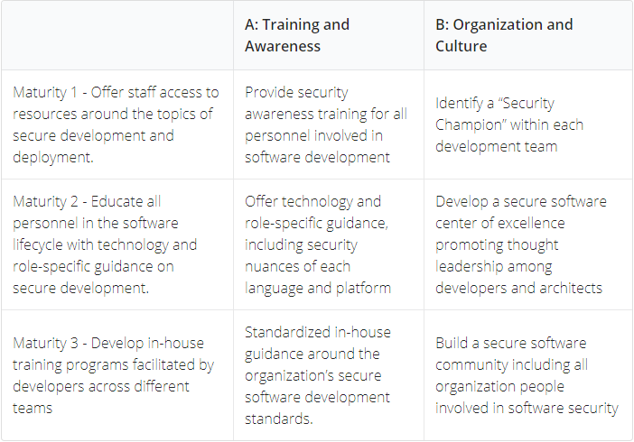
Education and Guidance
Streams
Maturity
Activities

Slide 9
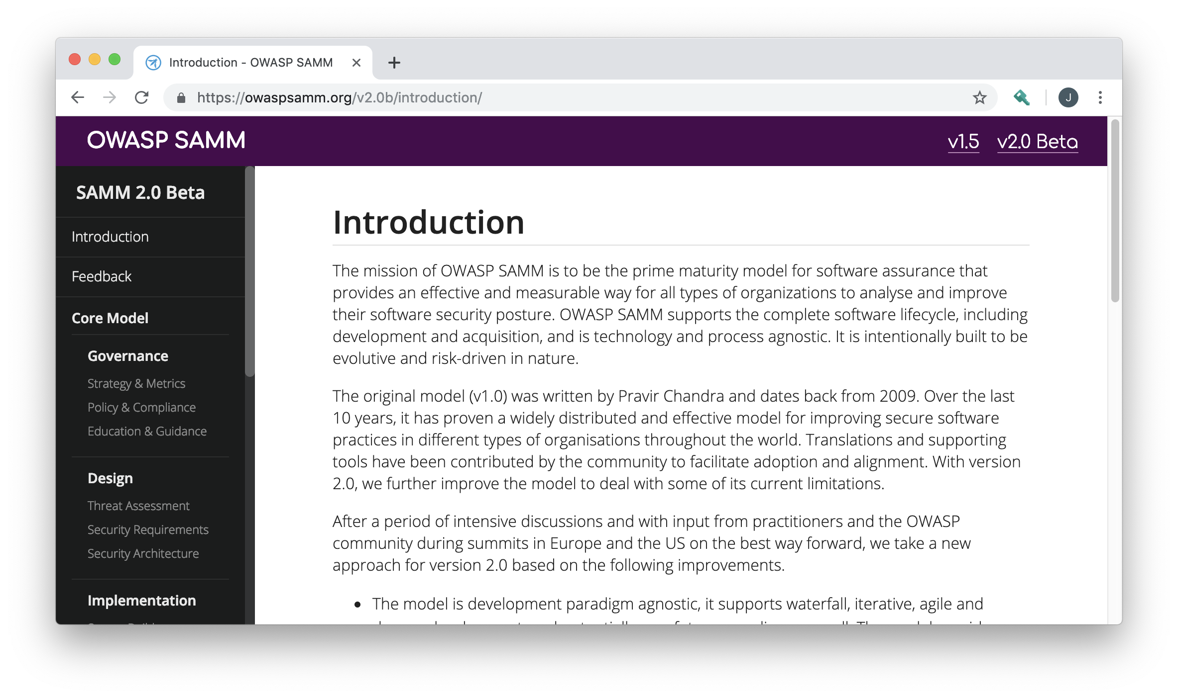
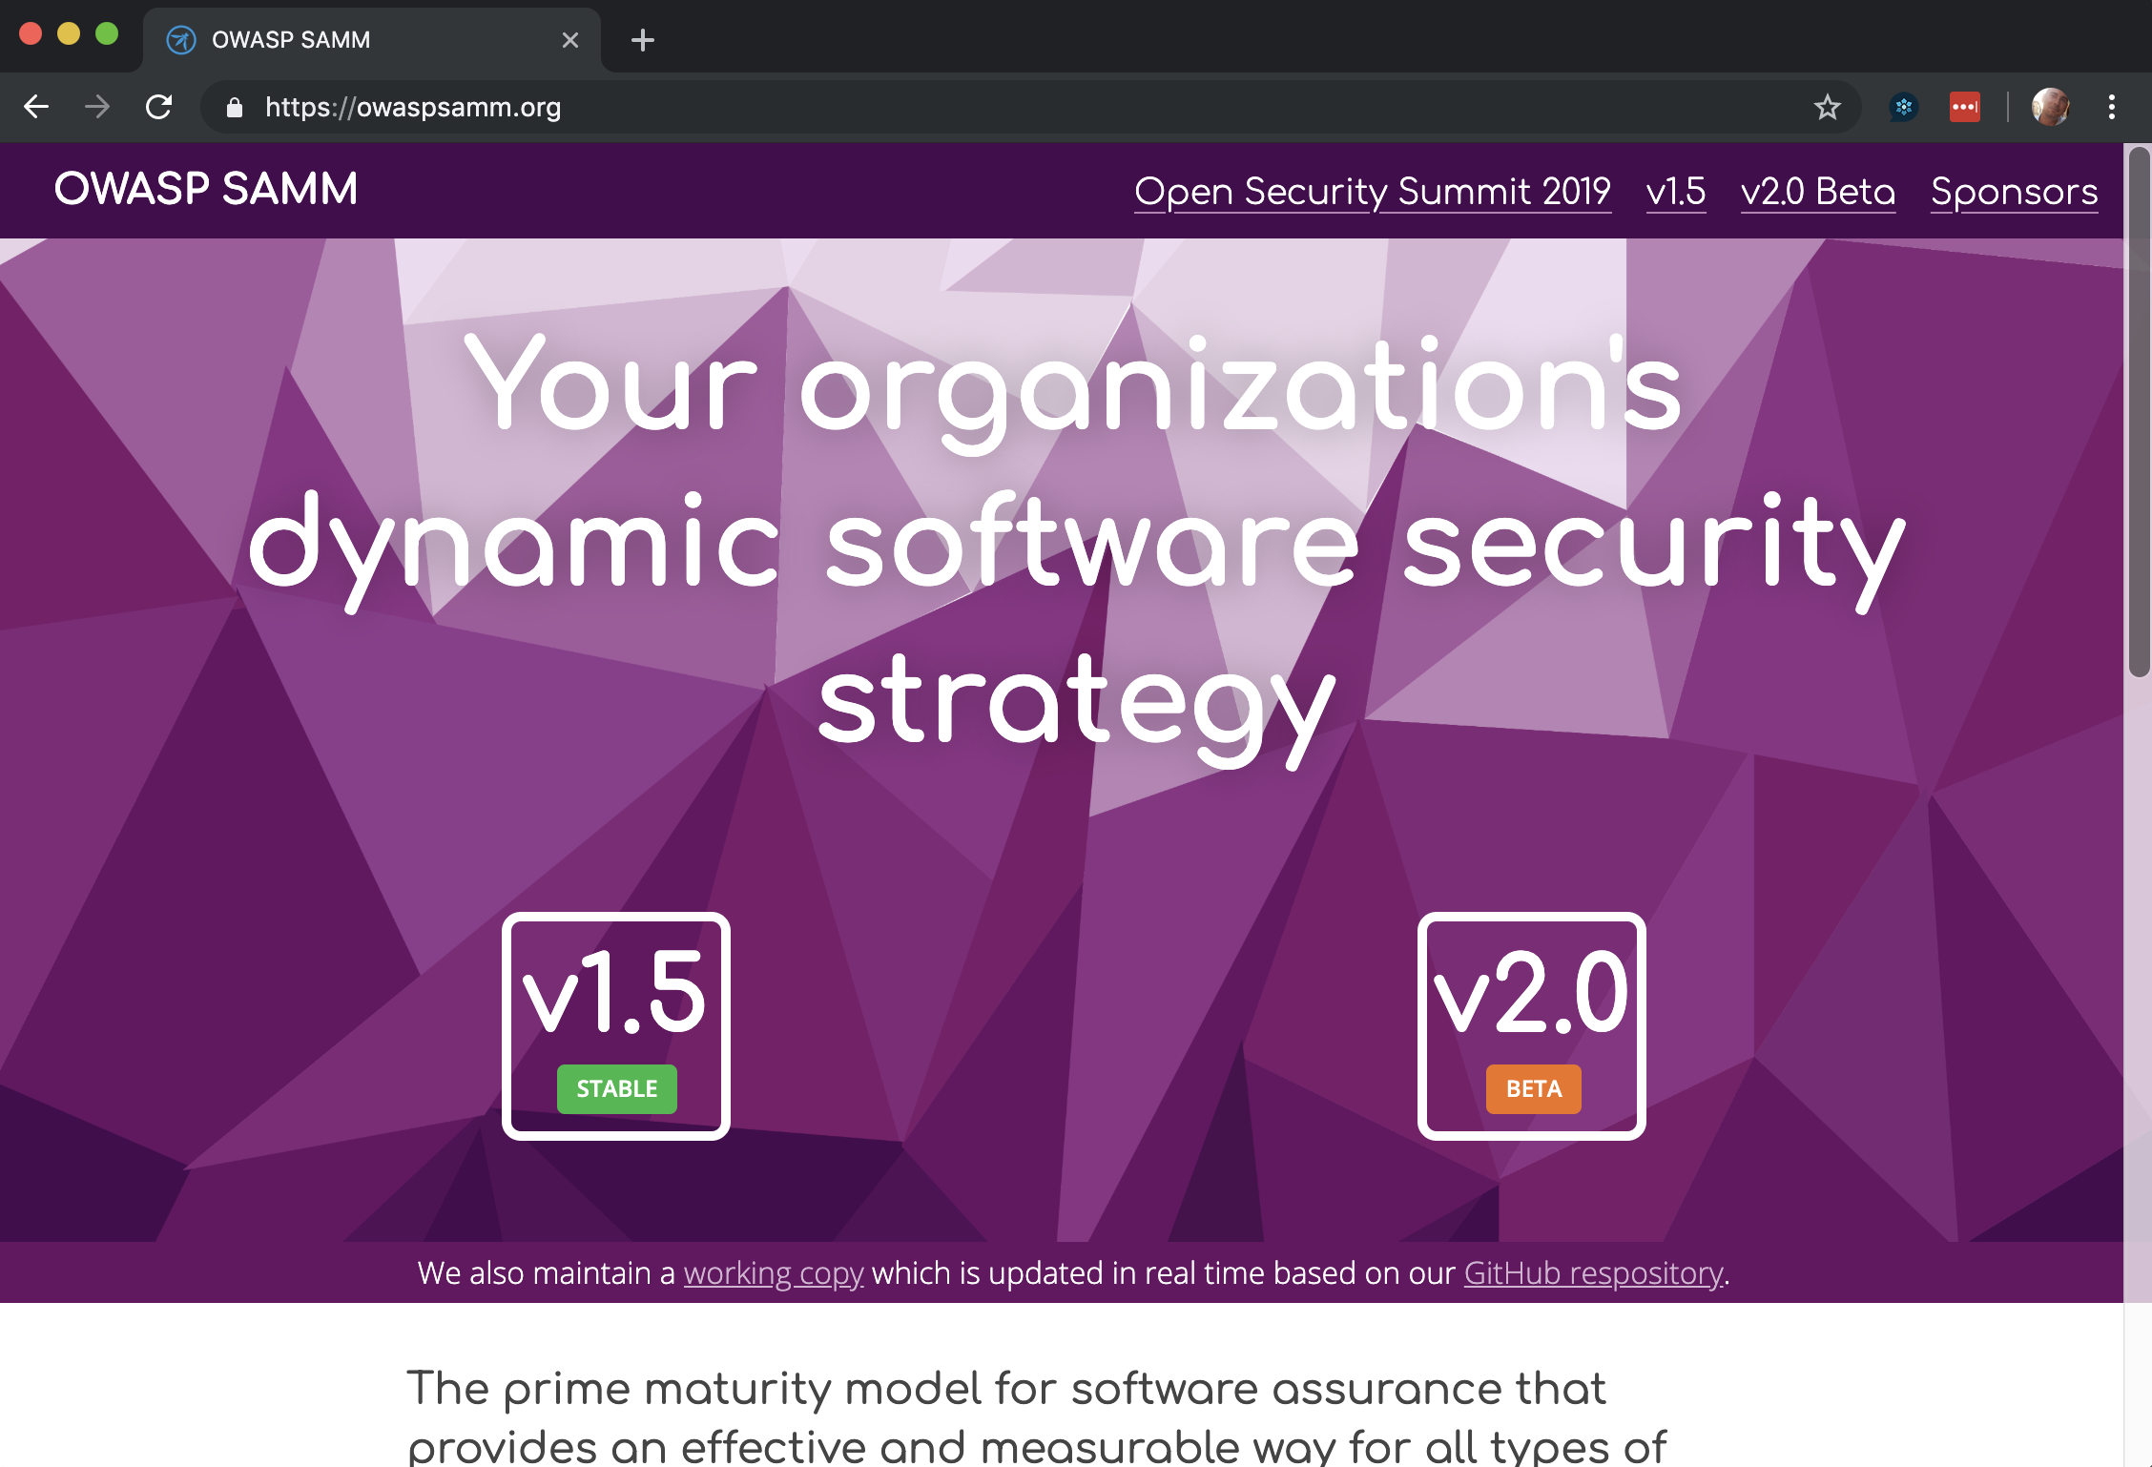
owaspsamm.org
Notes:
SAMM is built on a few core principles.
First, an organization's behaviour changes slowly over time. Changes need to be smaller and iterative to really take hold and make a difference.
Second, there is no single recipe that works for all organizations. SAMM is built with this in mind, and supports an organization building a program that is tailored to their risk profile, culture, IT maturity, etc.
Thirdly, Guidance related to security activities must be prescriptive. Too often, security initiatives fail due to poor details, lack of communication, or invalid assumptions.
Overall, the success of the program will be based on being simple, well-defined, and measurable.

Slide 10
Where to find SAMM
OWASP SAMM web site: https://owaspsamm.org
Version 1.5 documents and toolkit
Version 2.0 Beta content – Auto-updates from GitHub repo
GitHub Project: https://github.com/OWASP/samm
Includes background information and archived documents
SAMM project page on OWASP web site
Notes:
The core team provides monthly updates to the large community, as well.

Slide 11
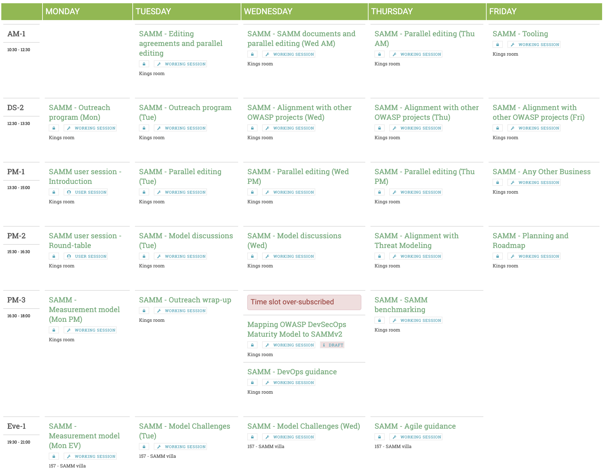
SAMM track @ OSS19
“nail” measurement model
add/improve questions
improve activities
process feedback
toolkit 2.0
align with threat modeling track
map DevSecOps maturity model
review agile guidance
…

Slide 12
SAMM future
SAMM 2.0, 2.1, 2.2, …
Iterate fast and release often
Gather and process feedback
Map OWASP projects
Add guidance profiles
Outreach
Grow adoption and community
Roadshow and trainings
Online tooling and benchmark

Slide 13
Contributors (non-exhaustive)
Bart De Win – Project Co-Leader, Belgium
Sebastien Deleersnyder – Project Co-Leader, Belgium
Chris Cooper – Web site, United Kingdom
John DiLeo – New Zealand
Daniel Kefer – Germany
Nessim Kisserli – Belgium
Yan Kravchenko – United States
Hardik Parekh – United States
Bruce Jenkins – United States
Brian Glas – United States
Rob van de Veer – Netherlands
Michael Kuipers - Netherlands
…
Notes:
Work on Version 2.0 has been performed mostly by a core team of seven volunteers. Since starting on the new version, the team has met in person three times, and have coordinated our work through fortnightly team calls.

Slide 14
Get involved
Provide feedback on the current draft
Submit issues in GitHub project: https://github.com/OWASP/samm
Join the monthly project calls
Second Wednesday of the month, 9:30 p.m. Central European Time
Join the Slack Channel
#project-samm on the OWASP Slack (https://owasp.slack.com/)
Stay up to date with the SAMM newsletter
http://eepurl.com/gl9fb9
Notes:
The core team provides monthly updates to the large community, as well.

Slide 15


Thank you sponsors
sponsor? info@owaspsamm.org

Slide 16
Lunch “working” sessions
SAMM OWASP projects alignments & mapping
Wednesday
Thursday

